Slide 1

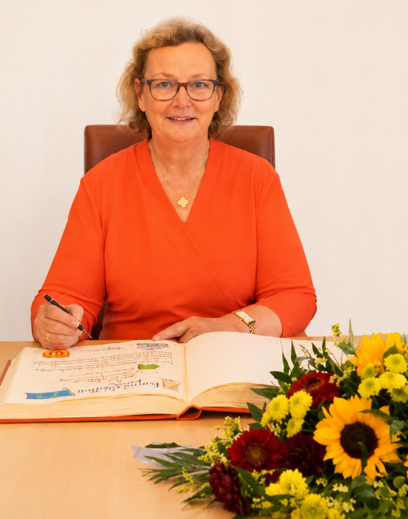
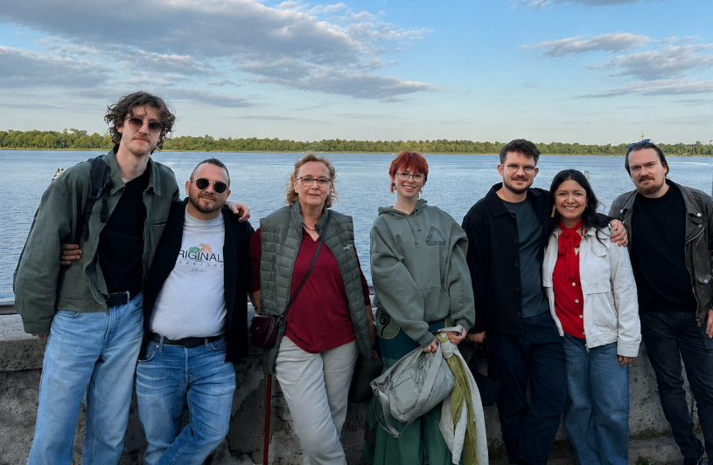
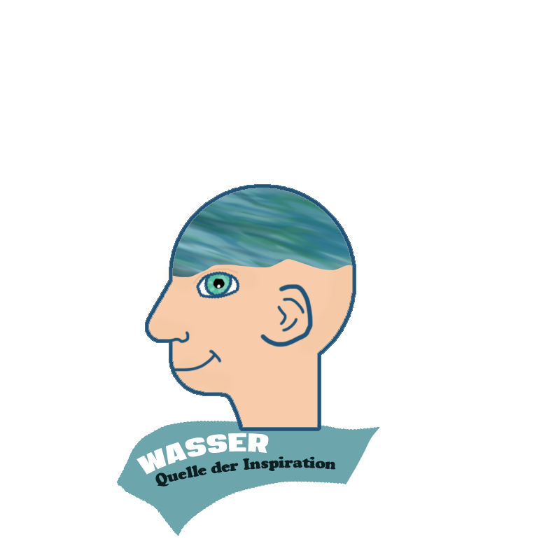
The project is coordinated by:
Westfälisches Forum für Kultur und Bildung e.V.
This project is coordinated by
Dr. Ulrike Kurth, CEO
And a great team supported
this project with ideas and material

Slide 2
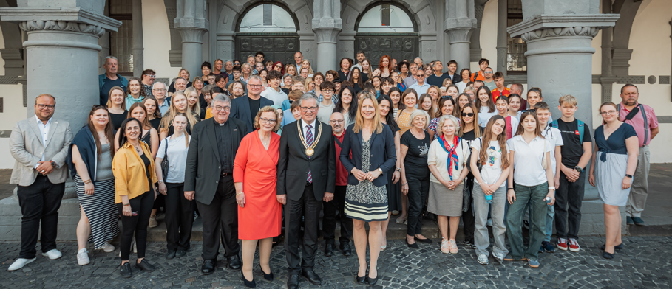
Our association was founded in 2003 and since then many different educational projects, training courses and conferences have been organized.
We cooperate with the city of Paderborn, the Archdiocese of Paderborn, the Bonifatiuswerk, the state of North Rhine-Westphalia and various partners in the region.

Slide 3
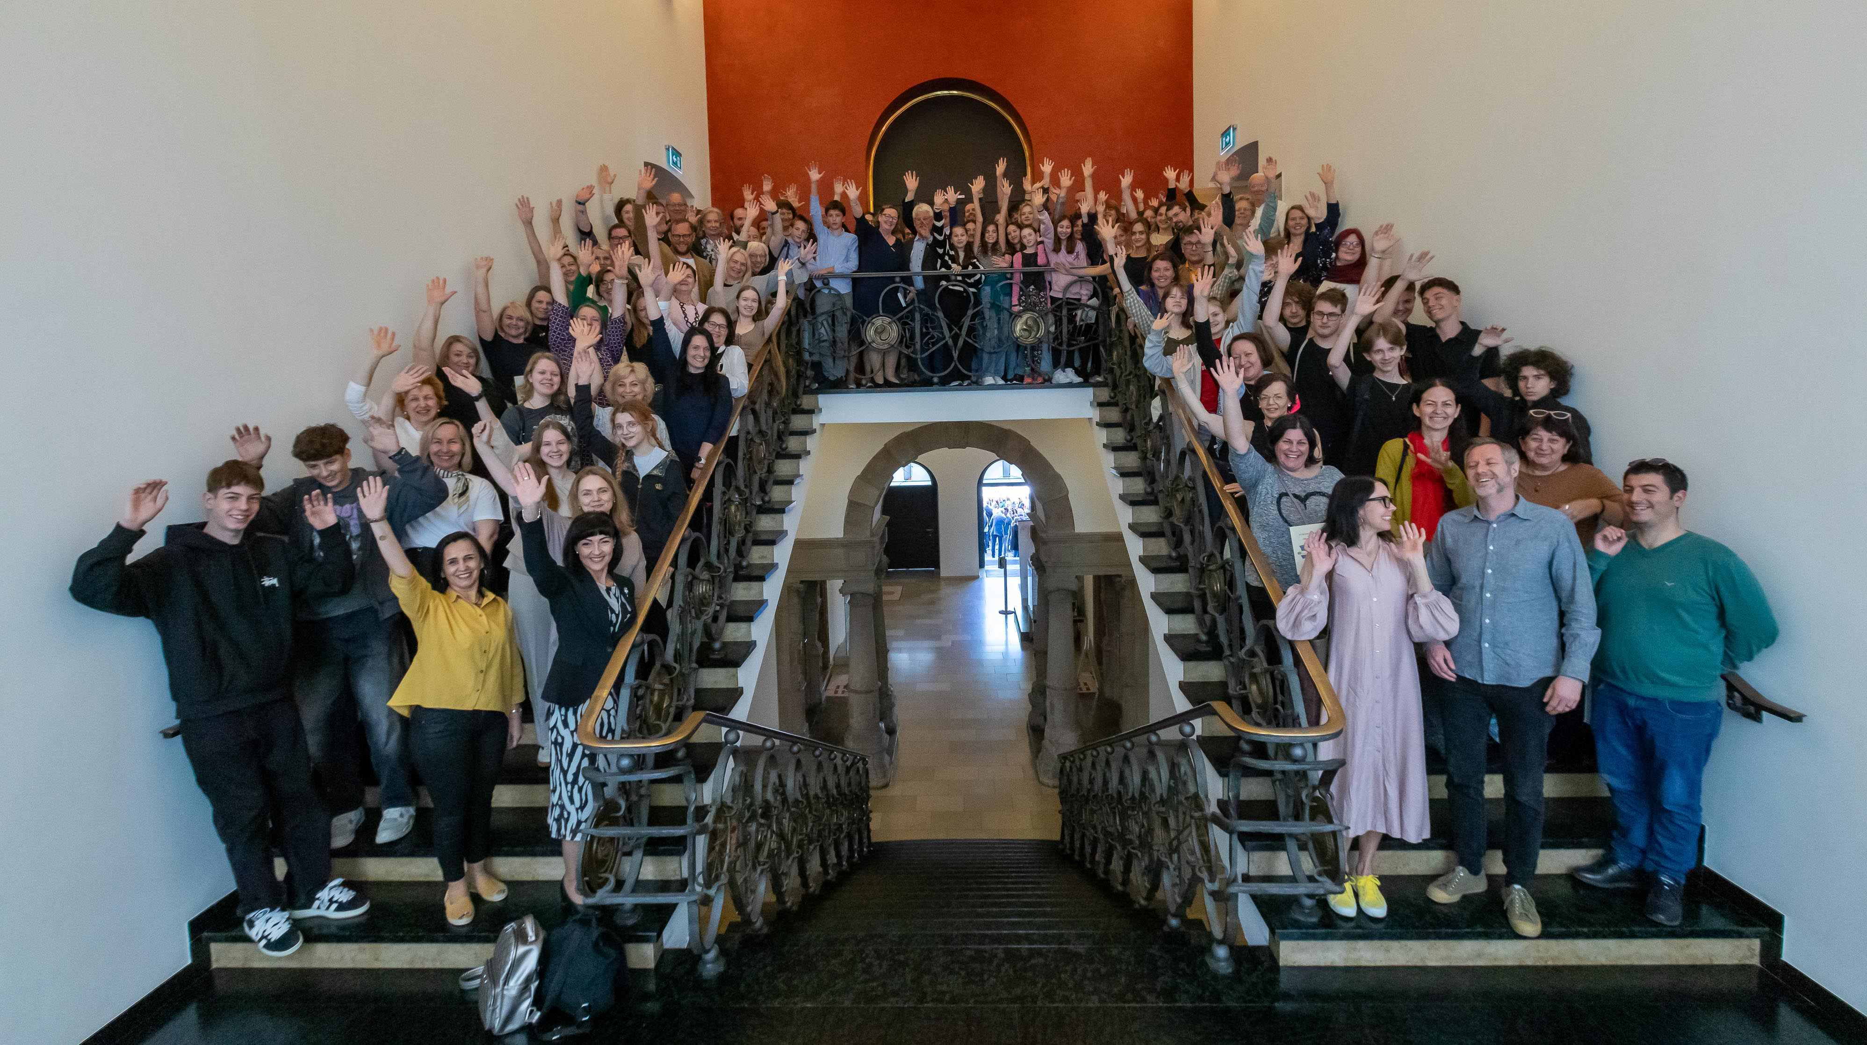
This year, the 24th international conference took place
with 120 paricipants from 16 countries.

