Slide 1

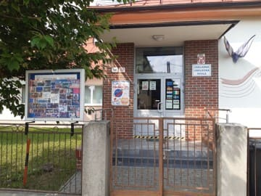
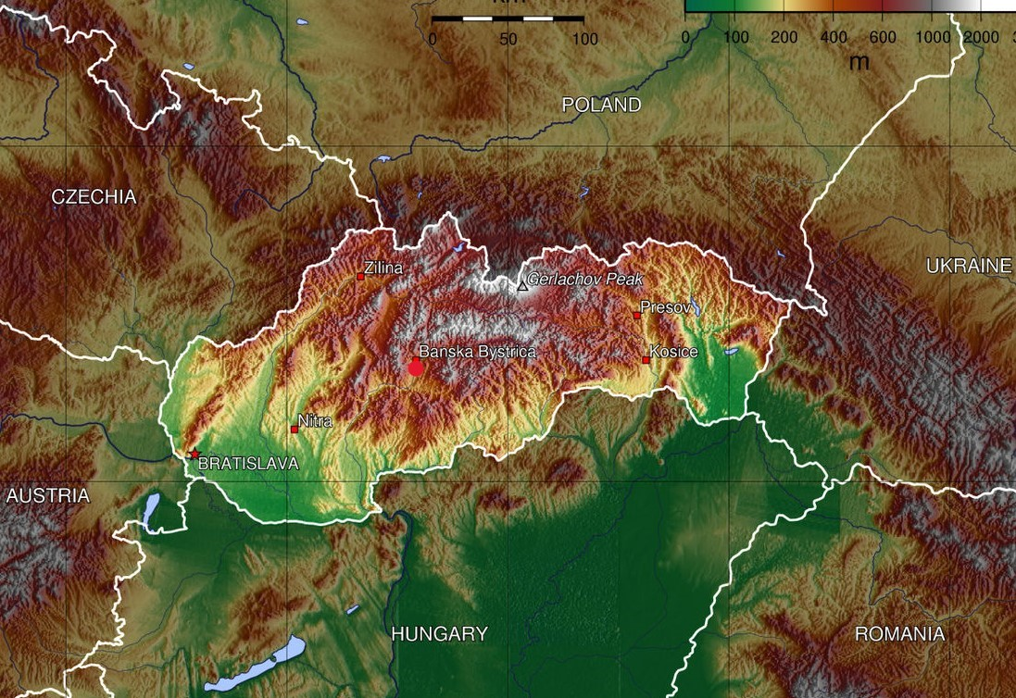
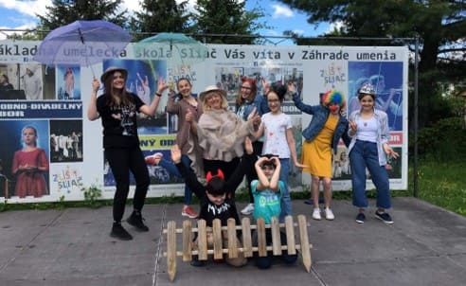

THE school of art sliaČ (slovakia)
Sliač
The school of Art Sliač has 59 years von existence.
It has got 20 employees, almost 400 students from 5 to 25 years of age.

Slide 2
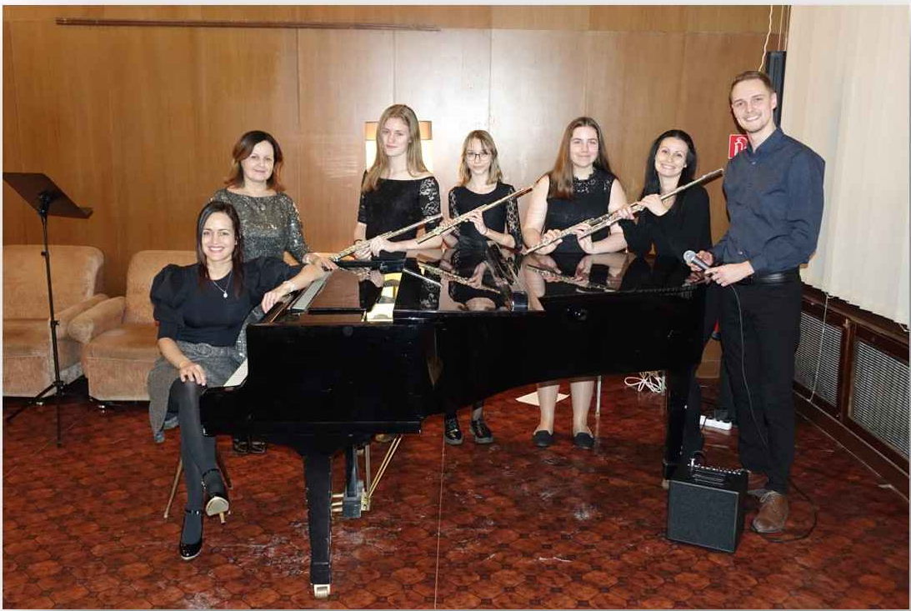
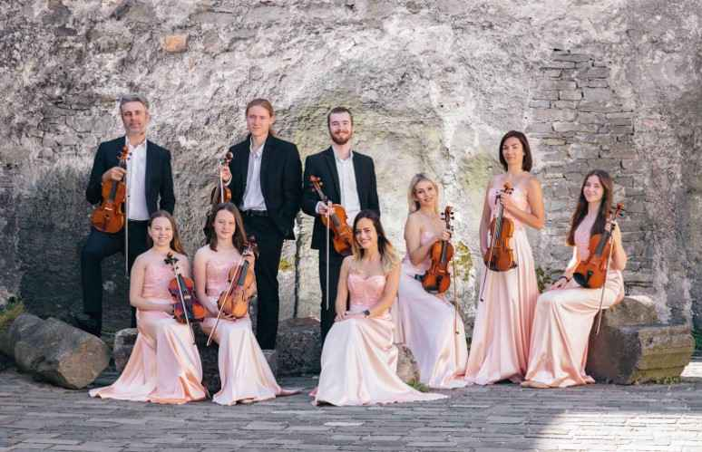
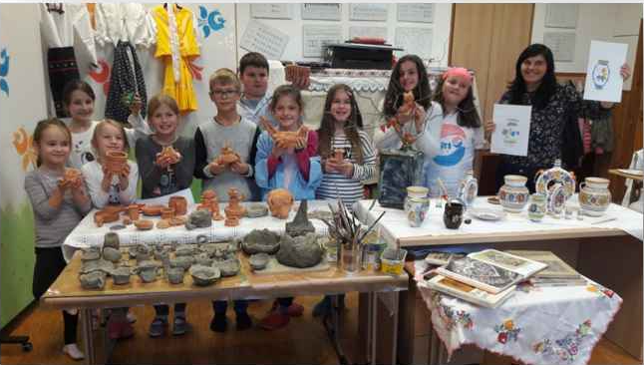
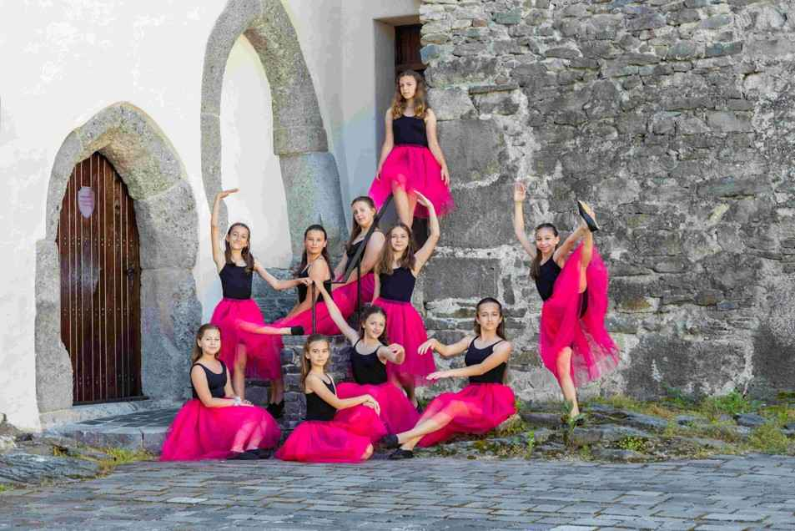
A public school, classified in the international standard classification
of education system (ISCED):
  ISCED 1B – the primary education – 4 years
  ISCED 2B – the lower secondary education – 4 to 5 years
  The second degree: 4 years
  The adult study: 4 years
A possibility of continuous education for individual student up to 17 years
School‘s educational program titled:
„Art – Education - Occupation“ and it is main document of our school.
The concept of the school offers creative professional forms of education for
students, which are not only developing their own skills, but they are also
preparing them for public performances, competitions, opening and dance shows of national and international scope, for example, also in European projects in which we have been participating for 12 years.
The school also focuses on intensive preparation of talented students for conservatories, high schools and universities with an artistic - pedagogical focus.

Slide 3
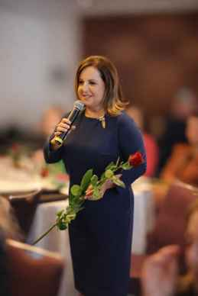
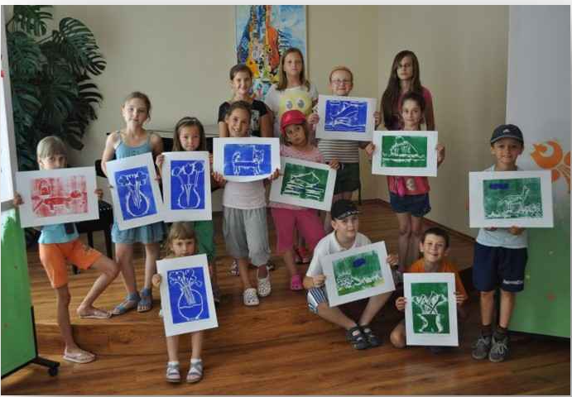
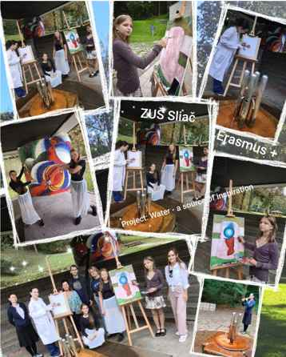
Dr. Alica Hancková
(director) and her Team
In the project “Water – Source of Inspiration” we look forward to new project challenges and new friendships, getting to know each other's cultures, history and the overall way of life of the participating countries, and especially their views on water.

