Slide 1
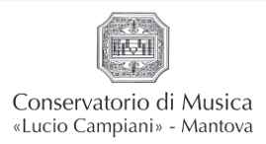
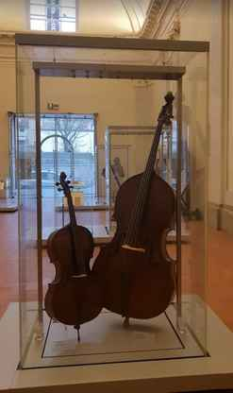
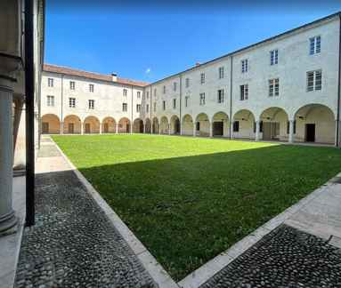

The Mantua Conservatoire offers a Level II Academic Diploma (two years). From A for accordion to T for trumpet, all
instrumental courses are available. In addition, there are courses in performing arts; that is, general music culture; choral practice,
orchestral practice; poetic and dramatic literature; Italian literature.
The library holds a collection of books, sheet music, CDs and manuscripts totalling around 8,000 items – the oldest of which are more than 100 years old. The library is constantly being expanded and is open to the public.

Slide 2
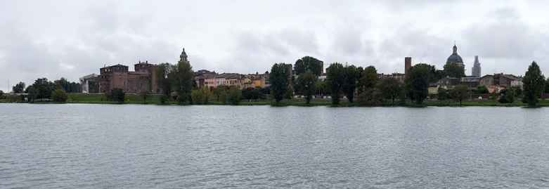

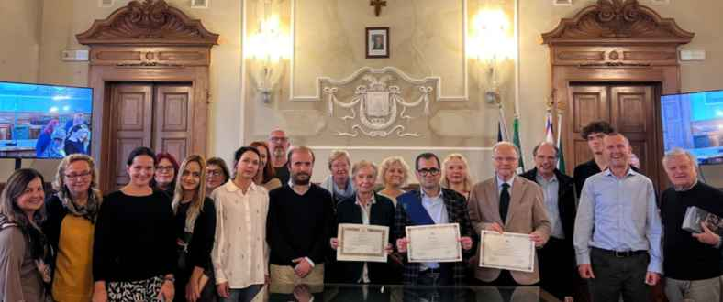
Water has been a constant feature of the city of Mantua for many centuries. To protect the city, three lakes were dammed up,
which in earlier times served as a moat to safeguard the city.
The project work started in this special city (World Heritage Site), because the „Source of Inspiration“ ist very much alive here.

Slide 3
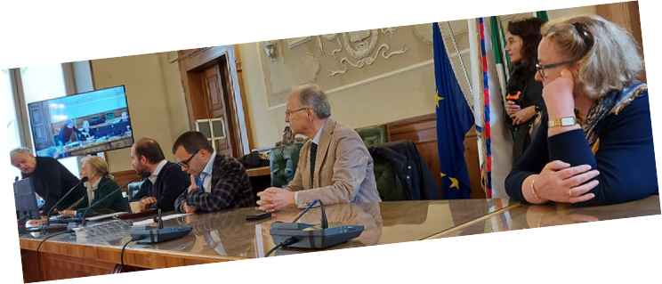
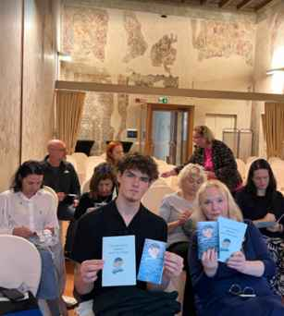
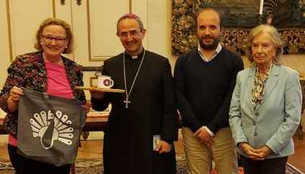
The Kick-off meeting in Mantua started with a reception hosted by the President of the Province of Mantua.
Also present were the director of the Conservatoire, the Italian consul, the chair of the Manuta–Paderborn town twinning association on the Italian side, and the chair in Paderborn.
The Workshops took place in historic rooms in an old Palazzo
In addition, the Bishop of the Diocese of Mantua received the group.

