Slide 1

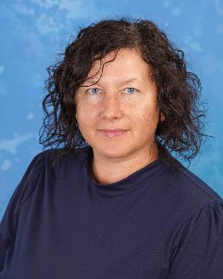
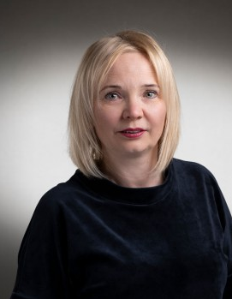
Riga Technical University
Liepaja Academy
Coodinator
Dr.paed., Prof. Maija Ročāne
Director
Dr. paed., Prof. Dace Medne

Slide 2
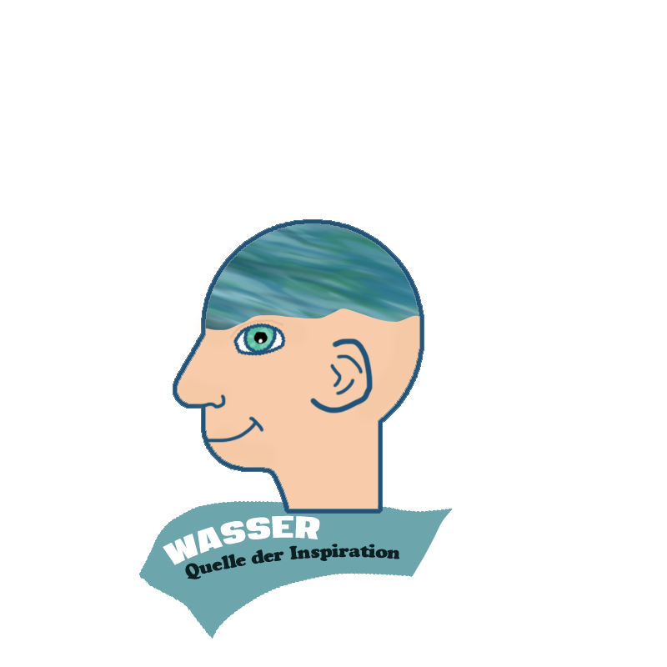
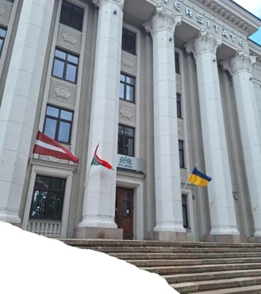
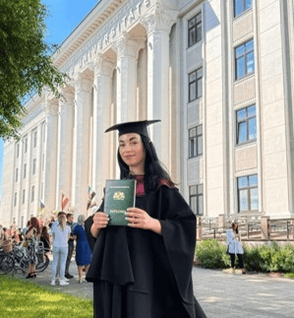

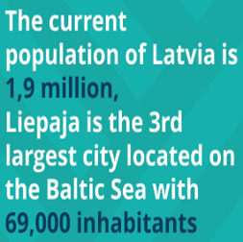
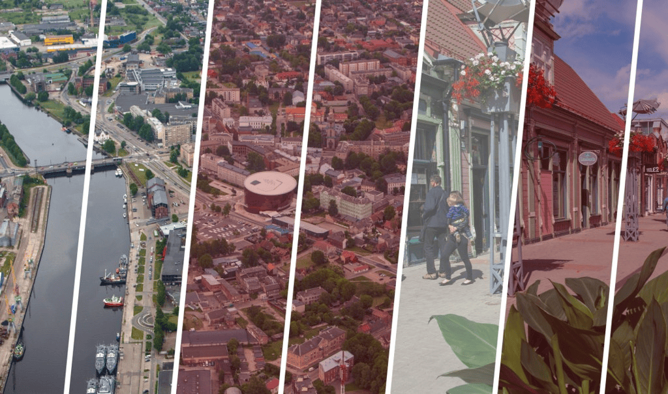
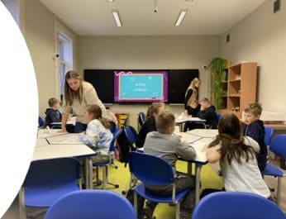
Riga Technical University Liepaja academy

Slide 3
Overall objectives of the participation in project
RTU Liepaja is a symbol of education, science and culture of Liepaja and Kurzeme region (Latvia) that provides competitive, and internationally recognized education. Our new challenge is to address local and global challenges, one of which is to address and raise awareness of students, teachers, and local community on environmental issues related to clean water.
1
To facilitate the different levels of coordination, as well as exchange of information, relative to different intercultural projects and products in the local level.
2
To facilitate future exchanges in RTU Liepaja at all levels and to promote intercultural projects and European programmes and other actions in the field of education.
3
To contribute to the development of the intercultural competences in teachers training programs.
4
To broaden educational experiences by being exposed to other systems.
5

Slide 4
Added value of participation
Students of RTU Liepaja, teachers and educators of Liepaja and Kurzeme region will be encouraged to look beyond and open themselves to others, as well focus on environmental issues.
New tools that will help to understand other cultures better will be created.
The results of different activities will be disseminated amongst home and partners institutions.

