Slide 1

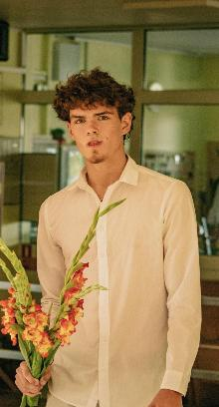
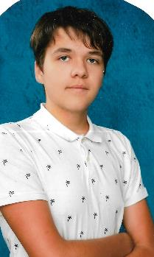

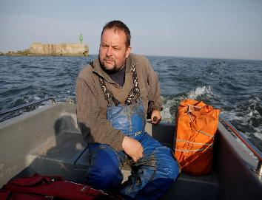
Liepaja Oskars Kalpaks
Secondary school
Researcher ichthyologist
Ēvalds Urtāns
Student grade 11
Madars Urtāns
Director Gints Ročāns
Student grade 11
Daniels Derkevics

Slide 2
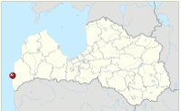

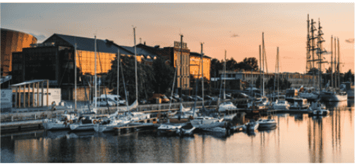
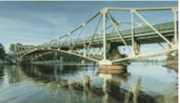

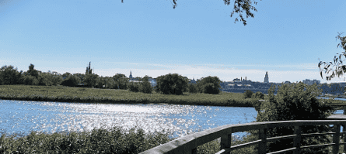
Liepaja

Slide 3

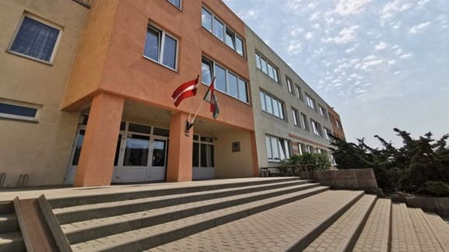
Liepāja Oskars Kalpaks Secondary School
is located in the Northern suburb of Liepaja at 96 O. Kalpaka Street, between one of the largest residential areas in the city and the port area, which is undergoing intensive development and the construction of an access road and railway to the Port of Liepaja. The history School dates back to 1 September 1989. The area of the school premises is 10171, the surrounding area - 38565 square metres.

Slide 4
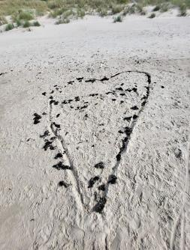
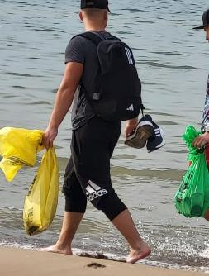
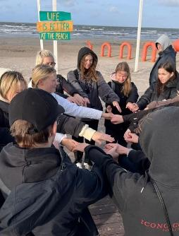
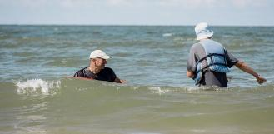
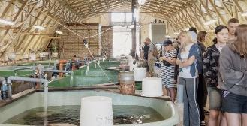
Caring for the environment is our priority

