Slide 1

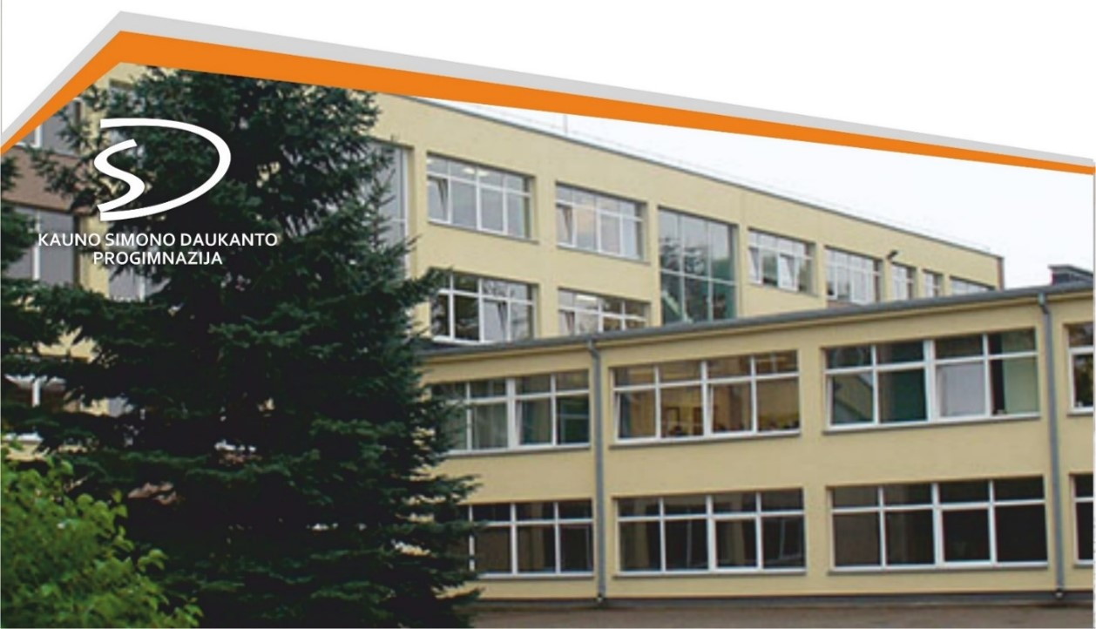
Kaunas SImonas Daukantas Progymnasium
There are 790 pupils at the Progymnasium.
548 pupils learn German as a 1st foreign language.
Year 1-4 - 56 pupils.
Year 5-8 - 492 pupils.
German as a 2nd foreign language:
5-8 grade - 208 pupils.

Slide 2

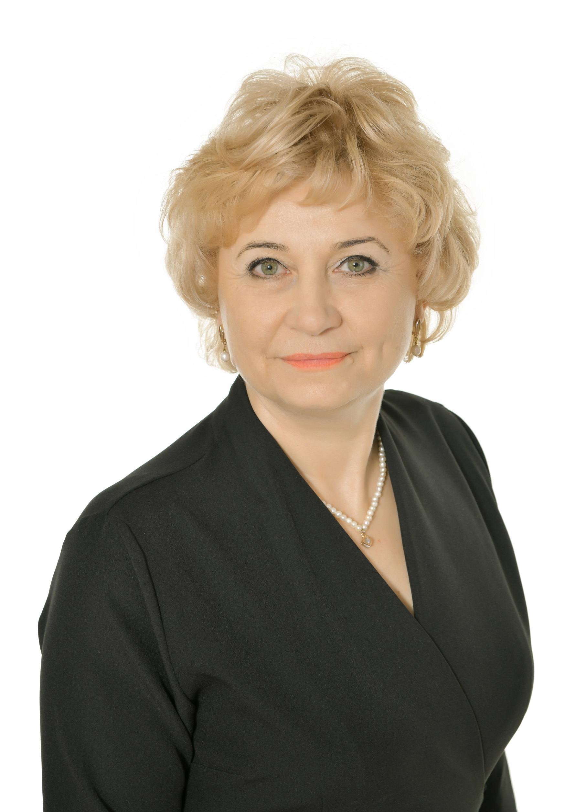

JEKATERINA JUKNEVIČIENĖ,
PROGYMNASIUM DIREKTORIN
GINTARĖ BUDRIENĖ,
INTERNATIONAL KOORDINATORIN FÜR DEUTSCHPROJEKTE

Slide 3
What makes our school special?
2015: implementing a distinctive all-day school model
2017: starting the CLLIG project (German integrated in specialised lessons)
2017: being a member of the Lithuanian STEAM school network
2017: Conclusing a contract with Goethe Institut
2018: recognised by a decision of the Lithuanian Minister of Education and Science as a school that has strong characteristics of a good school. 30 schools in Lithuania are in the ‘Quality Basket’

Slide 4
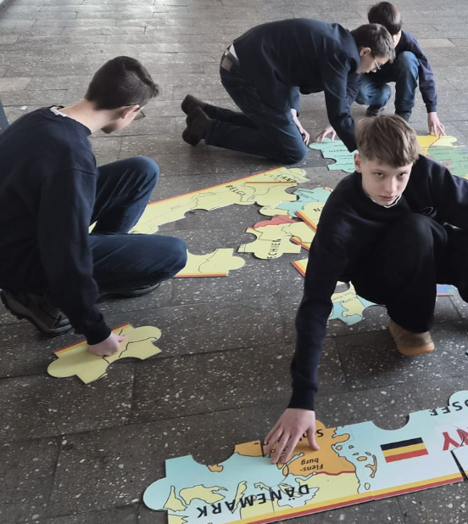
What makes our school special?
2020: accredited and recognised as an advanced member of the
European STEAM School Network.
Every year we carry out at least two science projects
in the field of ERASMUS+.
The contract to implement science projects was extended
in 2020 and 2023 following an evaluation of our performance.
We implement the project ‘Schools: Partners for the Future’ (PASCH).
There are only two schools in Lithuania participating in this programme.

