Slide 1

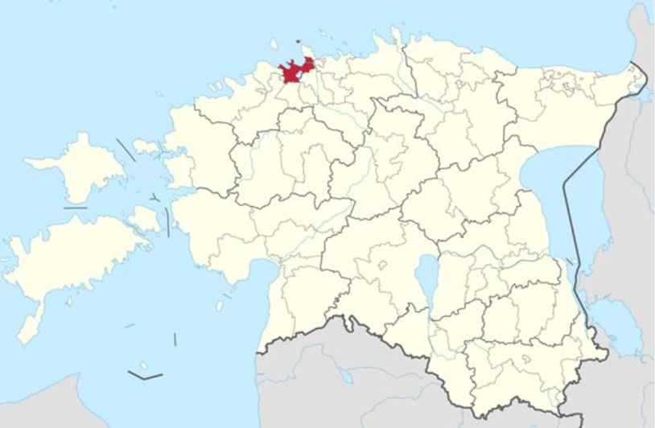
Tallin in Estonia
Size: 45 000 km2
Population: 1.3 million
Language: Estonian
Capital: Tallinn
Population of the capital: 460.000

Slide 2
Founded in 1960
Since 1962 intensified German lessons
Language diploma school since 1996
128 employees
507 male and 574 female students (1081)
- European projects for 30 years
(Erasmus+ Digitectives@Work on Environmental Protection and Biodiversity Measures, Erasmus+ Europe.Bee.Digital – Using Digital Technologies in School Projects, Erasmus+ FuturClass)

Slide 3
