Slide 1
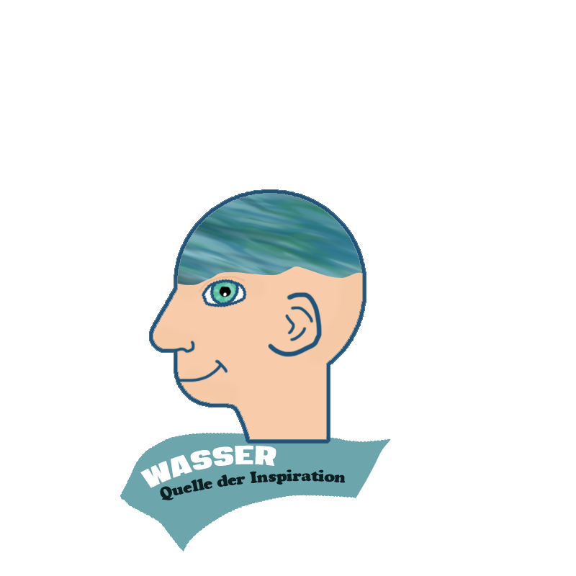

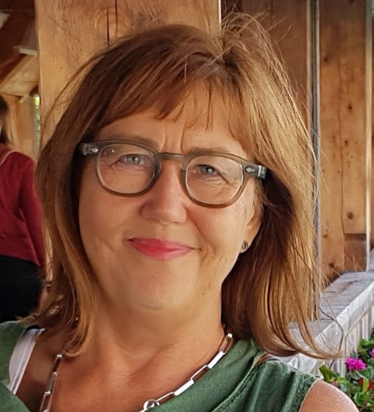
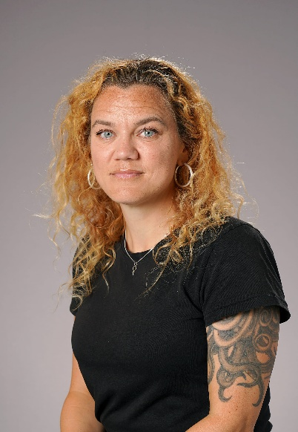
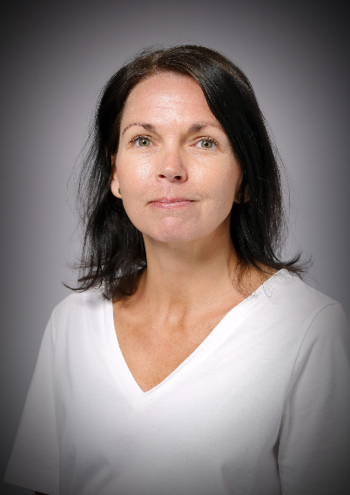
Susanne Wilzén Eriksson Louise Halldin Therése Anelind
Senior International Coordinator Teacher of English and Swedish Head of Social Science Department
How different aspects of the element of water
affects our lives in different perspectives!

Slide 2
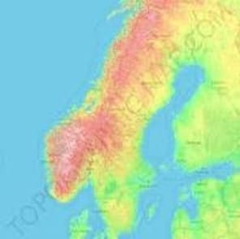
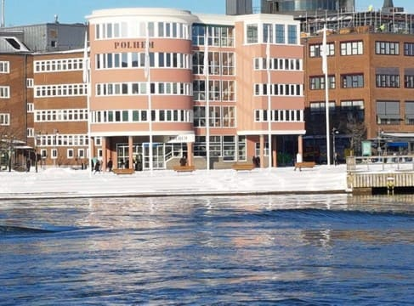
POLHEMSGYMNASIET
GOTHENBURG SWEDEN
FOUNDED IN 1829
PRESTIGIOUS UPPER SECONDARY SCHOOL PREPARING STUDENTS FOR UNIVERSITY
PROFILES FOR DIFFERENT PROGRAMMES:
NATURAL SCIENCE
TECHNOLOGY AND DESIGN
ECONOMICS
SOCIAL SCIENCE
1500 STUDENTS
120 EMPLOYEES
ENGAGED IN INTERNATIONAL PROJECTS SINCE 1990´S

