Slide 1
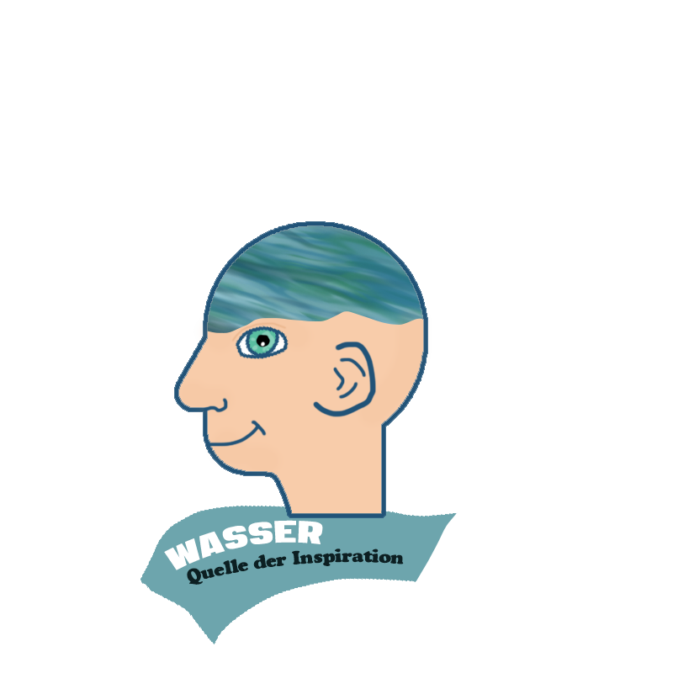



Following the water‘s flow
Daria Fomina
cooperative educational measure

Slide 2
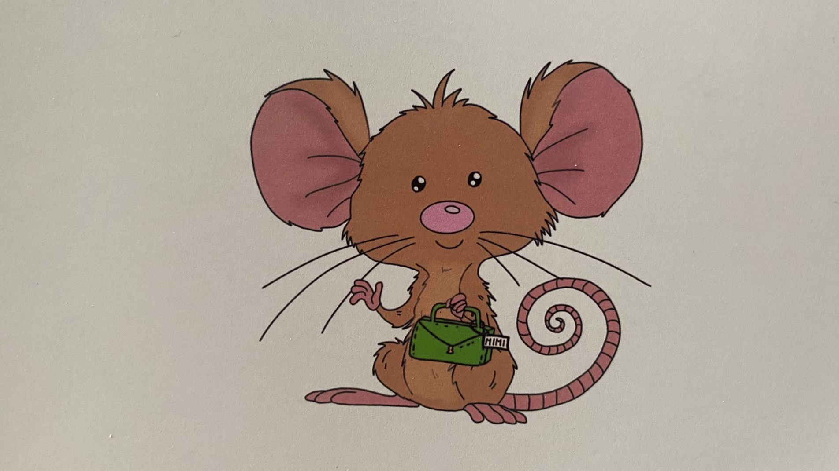
Mimi die Museumsmaus – Mimi the Mouse of the Museums

Slide 3
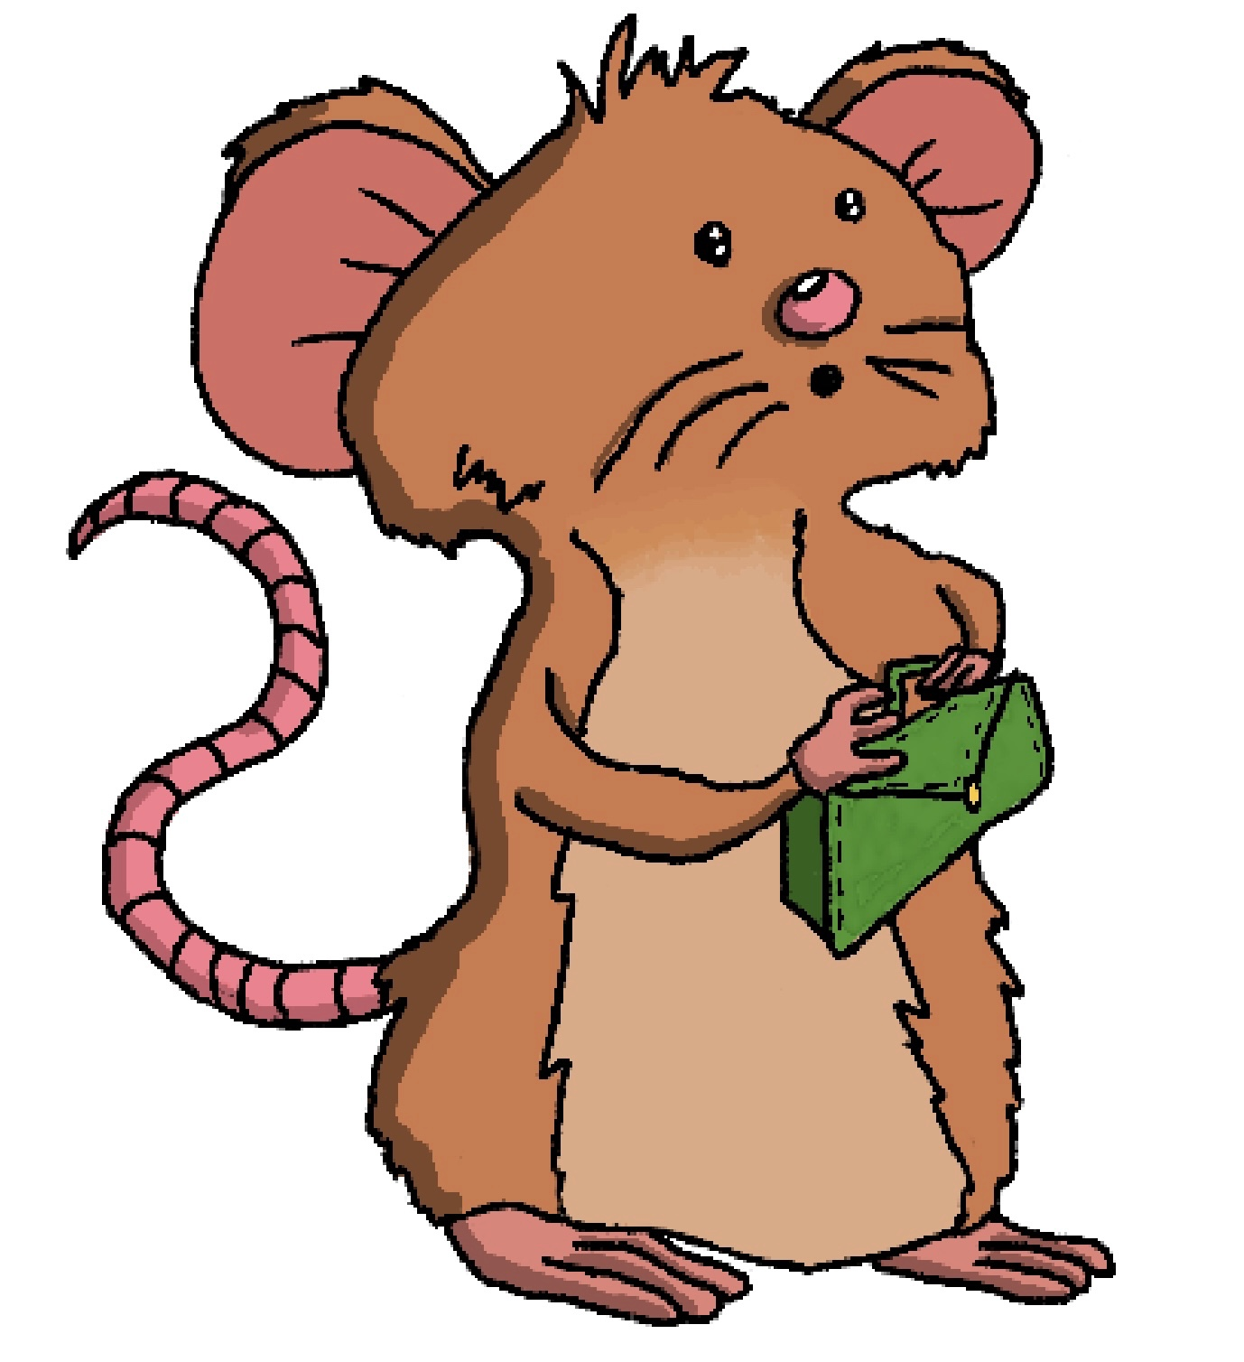
Chapters and Topics
Countries and their waters
Environmental issues
Water as a social and cultural source
Science in and around water

Slide 4
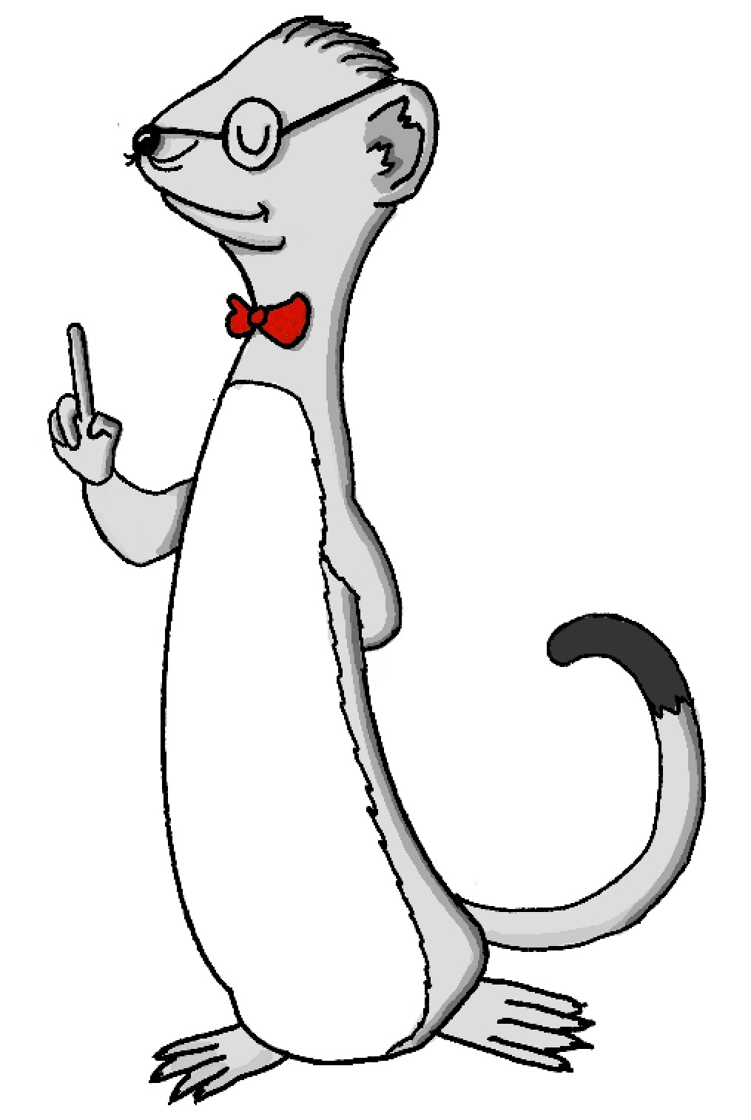
New Friends
Wido der Wieselschaftler – Wido the Weasel Scientist
Experiments
Explanations on scientific questions
Academic way of analyzing
Exercises and puzzles

Slide 5
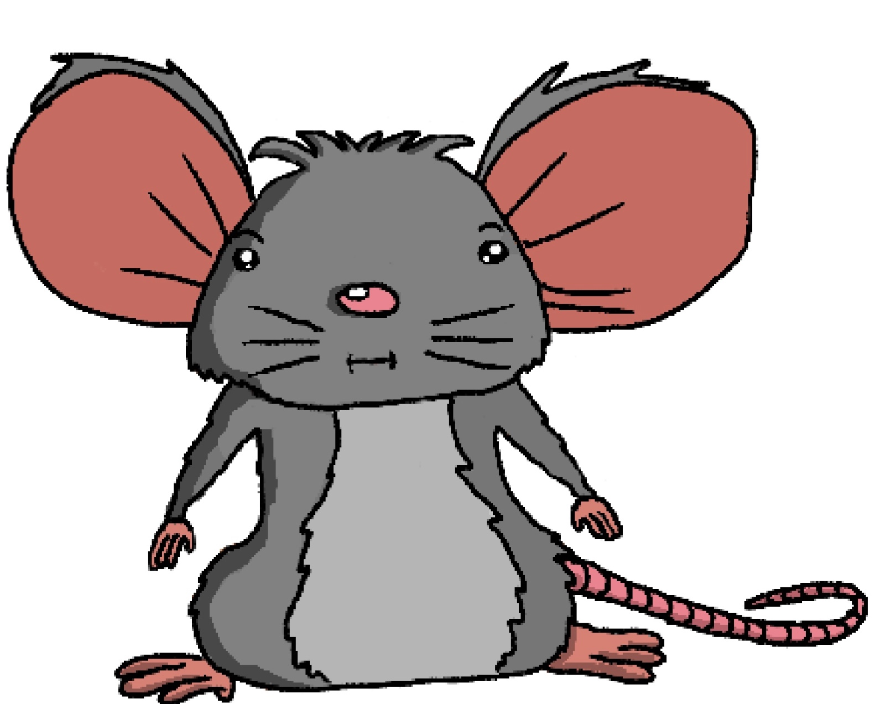
New Friends
Mimi‘s Family
Main characters in the stories
Guiding positions as hosts
Cultural and social informants

Slide 6
Example: Stefan from Sweden
Diving in the Gullmarsfjorden
Learning about geology, flora and fauna
Appreciation of nature as reasoning for research and protection
Cultural context and transferability of learnt material
Learning about nature as a way of learning about oneself and others

Slide 7
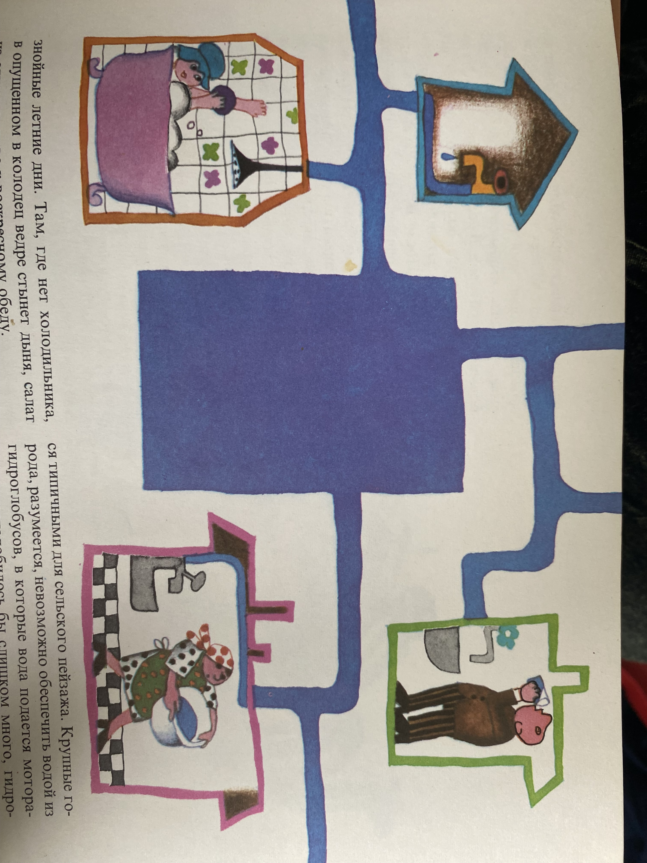
Further topics and ideas
Why does it rain?
How do rivers and lakes form?
Production of energy by water, today and in the past
Flora and fauna in different waters
Water as a way of transportation
What is cultural heritage, and why is water part of it? (ex. Mantua)
Dangers and pollution
Book of stories
Supporting digital media
  Widos science explanations
  Puzzles, exercises, experiments

Slide 8
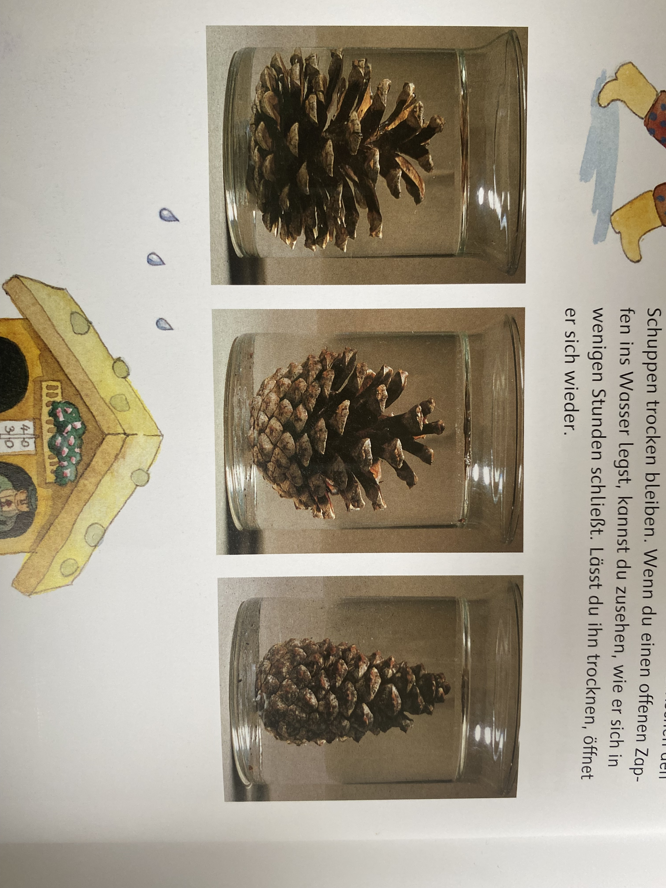
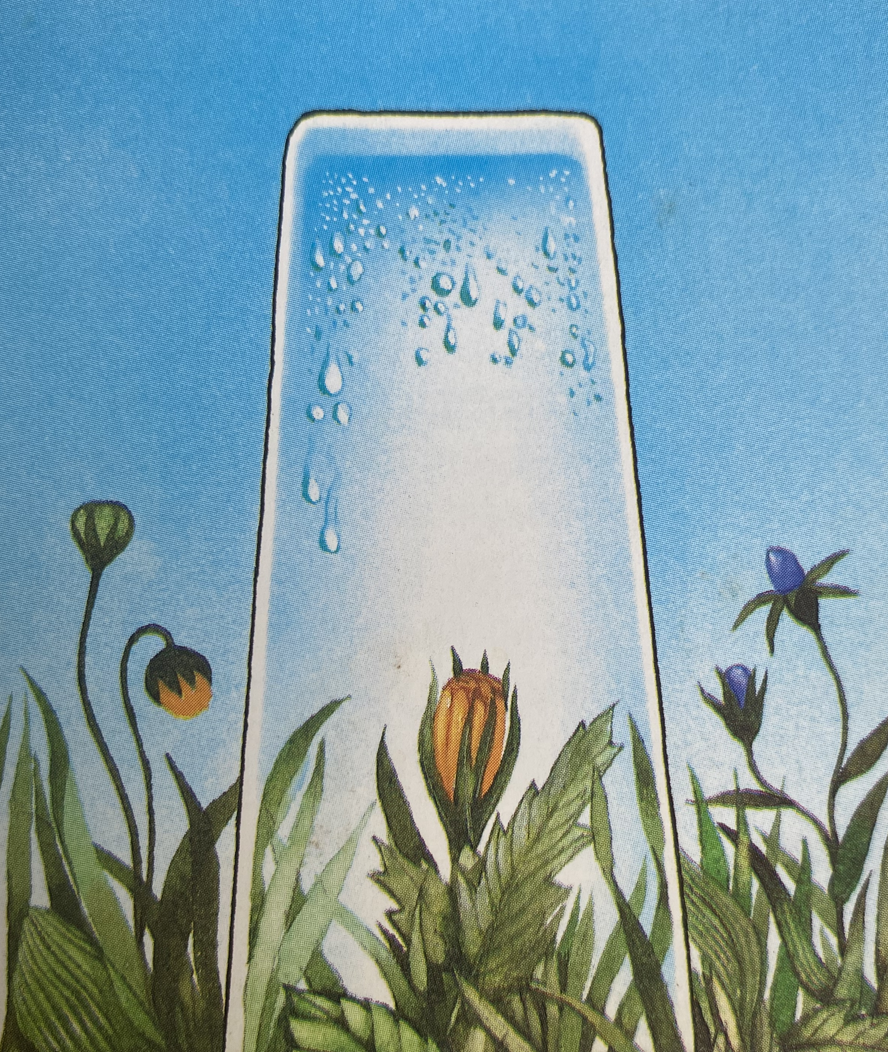
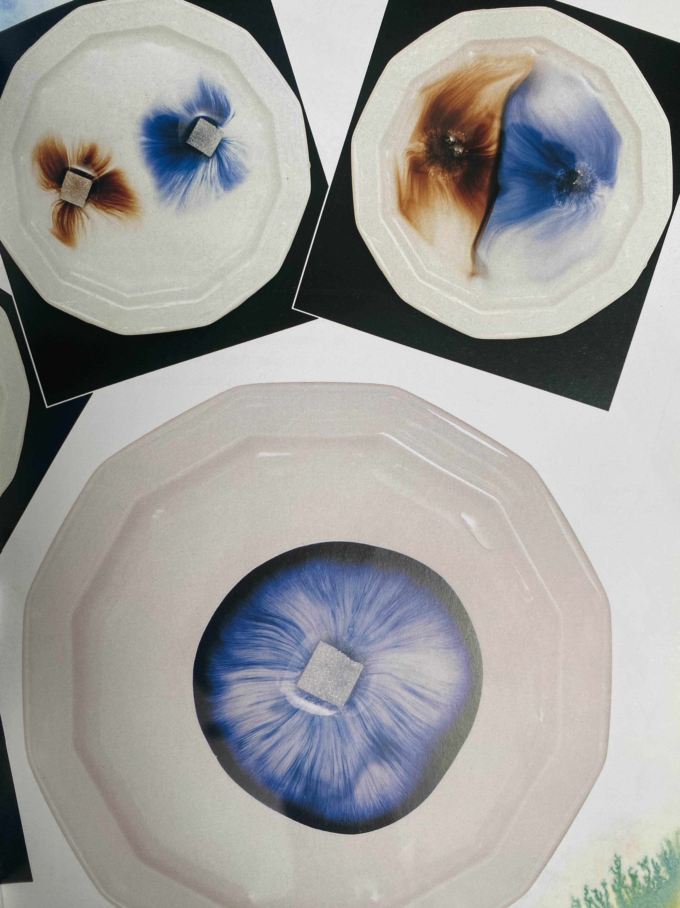
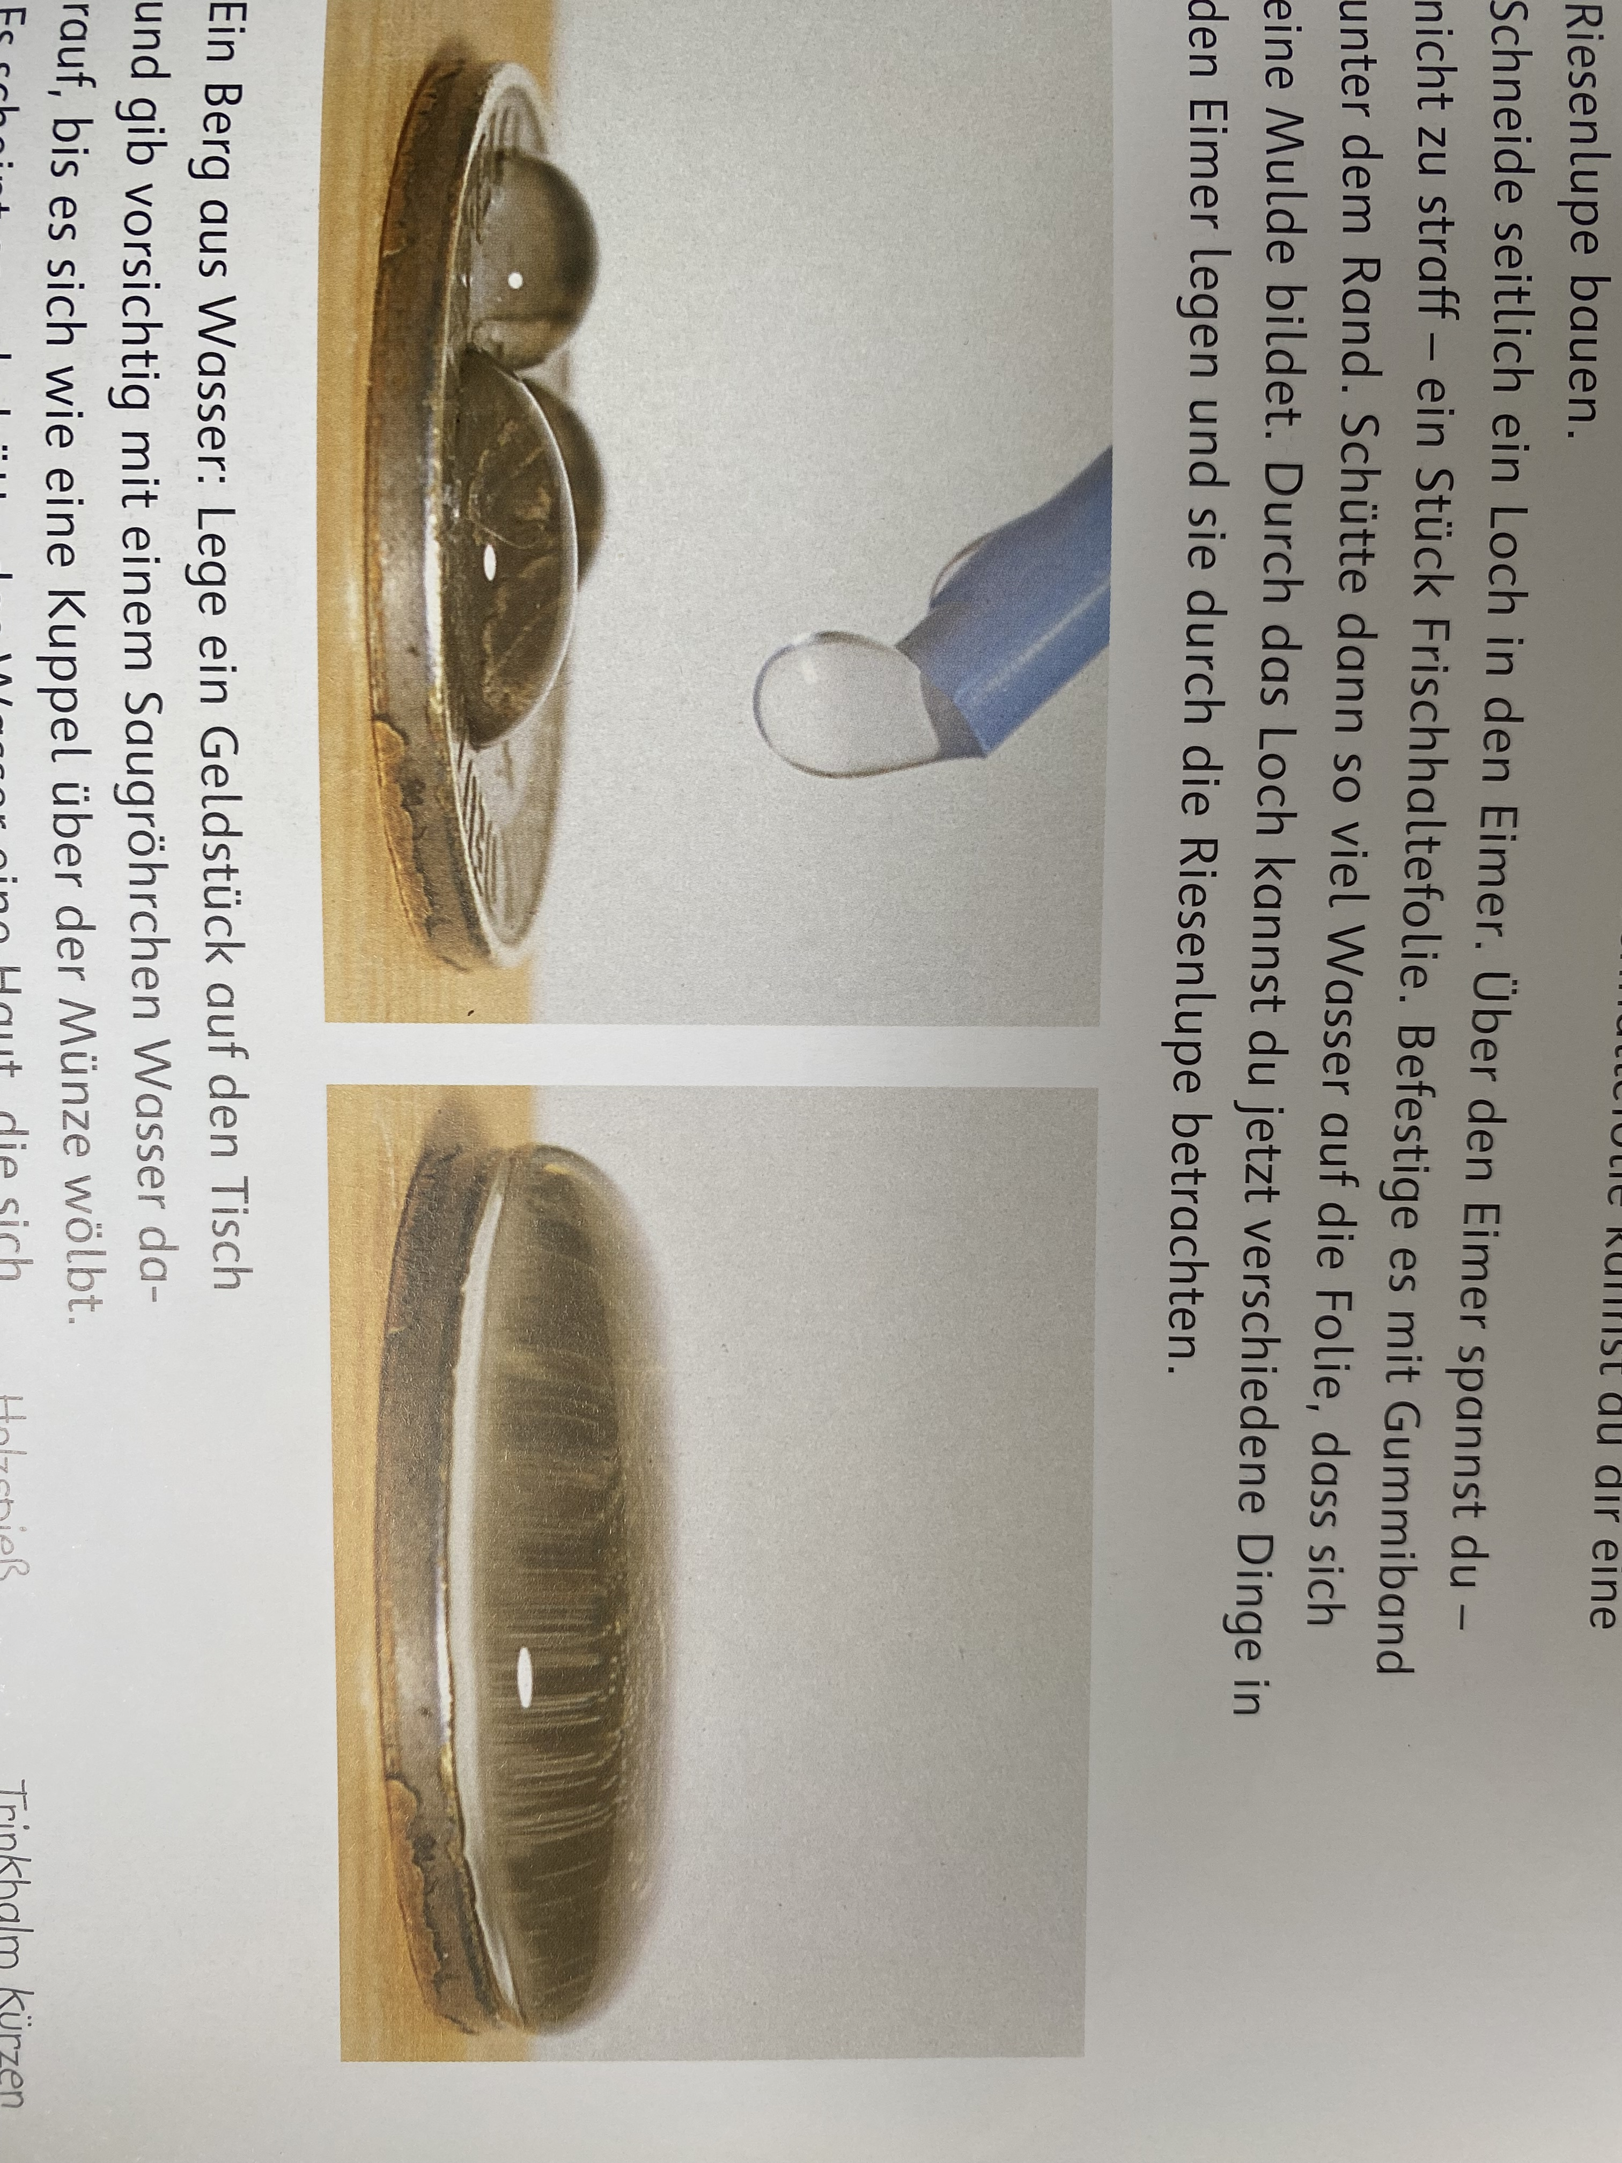
Experiments
For in-school projects or at home
Some examples:
  Opening and closing of a fir-cone in water
  Surface tension on a coin
  Condensation in a Glass over a Flower
  Fantastic colors with ink and sugar

Slide 9
What‘s the point?
Drawing attention to environmental issues
  Laying out the need for protection
  Creating proximity to nature
Expansion of horizons on a european scope
  Cooperation
  Promotion of cultural interests
Interdisciplinary education model
  Development of different competencies
  Interconnected media and information
  Expanding the view of oneself and the world

Slide 10
What‘s the point?
Aesthetic education
  reaching over the bounds of rating systems
  Formation and articulation of personality
  Artistic and abstract thinking as sustenance for teaching and learning processes
Concepts oriented on practical experience
  Topics are fully exhausted through the use of multiple perspectives
  Combination of different subjects
Adaptable materials
  Flexible time use by shortening or broadening the topic
  Variable intensity by age group and media

Slide 11

Friedrich Schiller:
“Man is only fully human when he plays.“
„Der Mensch ist nur da ganz Mensch, wo er spielt.„
In: Ästhetische Erziehung des Menschen – On the aesthetic education of man. (1795)
Freedom of the person in relation to the state: the realization of the individual by a moral-based understanding of beauty

Slide 12
Sources, literature
Andrash Sharvari, Eva Gaal: Who drinks what? (Org.: Андраш Шарвари, Ева Гаал: Кто что пьет?), Hungary, 1978.
Hermann Krekeler, Marlies Rieper-Bastian: Exciting Experiments. Playfully exploring natural sciences. (Org.: Spannende Experimente. Naturwissenschaft spielerisch erleben.) Germany, 2007.
Prof. Siegfried Aust: Was ist was– Wheather. In russian translation by the publisher Slovo, Org. Tessloff Nürnberg,1989.
Ulrike Kurth (editor): New stories of the museum mouse. (Org.: Neue Geschichten der Museumsmaus.) Bielefeld, 2025.
Claudia Vorst (editor): Aesthetic learning: subject-didactic fundamental questions and practice-oriented concepts in the interdisciplinary contextof teacher education and school. (Org.: Ästhetisches Lernen : fachdidaktische Grundfragen und praxisorientierte Konzepte im interdisziplinären Kontext von Lehrerbildung und Schule.) In: Studien zur Germanistik und Anglistik : 18. Frankfurt am Main, 2008.
Friedrich Schiller: On the aesthetic education of man, in a series of letters. (Org.: Über die ästhetische Erziehung des Menschen, in einer Reihe von Briefen.) 1795. Frankfurt am Main, 2009.

